Slide 1
BIRD
STRIKES ANALYSIS REPORT
EGBOSIMBA CHINENYE

Slide 2
BIRD STRIKES ANALYSIS
COUNTRY: UNITED STATES OF AMERICA
PERIOD: 2000 - 2011

Slide 3
INTRODUCTION
This report presents a comprehensive analysis of bird strikes in the aviation sector across the USA between 2000 and 2011. The report covers key factors including the involved airports, airline operators, flight phases, altitude at the time of the strike, the number of wildlife strikes, and the resulting damage to aircraft. This analysis aims to identify patterns and provide insights that could lead to innovative solutions through technology and artificial intelligence, with a focus on Multi-Agent Systems (MAS) for improving response and prevention.

Slide 4
OBJECTIVES
The primary objective is to explore ways of utilizing technological advancements and AI, particularly MAS, to mitigate the impact of bird strikes in a distributed and efficient manner. Key insights will be extracted to determine the critical indicators influencing bird strike incidents across the USA.

Slide 5
CASE STUDY
Visuals Depicting the Number of Bird Strikes
Yearly Analysis & Bird Strikes in the US
Top 10 US Airlines in terms of having encountered bird strikes
Airports with most incidents of bird strikes – Top 50
Yearly Cost Incurred due to Bird Strikes:
When do most bird strikes occur?
Altitude of airplanes at the time of the strike
Phase of flight at the time of the strike.
Average Altitude of the airplanes in different phases at the time of the strike
Effect of Bird Strikes & Impact on Flight
Effect of Strike at Different Altitude
Were Pilots Informed? & Prior Warning and
Effect of Strike Relation

Slide 6
TOOLS
Data Cleaning: Microsoft Excel
Analysis and Visualization: Power BI

Slide 7
DATA OVERVIEW
The dataset comprises 25,558 records, each representing a bird strike event from 2000 to 2011 at various airports and airlines. Key fields include:
Record ID
Airport: Name
Altitude bin
Wildlife: Number struck
Effect: Impact to flight
Flight Date
Effect: Indicated Damage
Aircraft: Airline/Operator
When: Phase of flight
Conditions: Precipitation
Conditions: Sky
Pilot warned of birds or wildlife?
Cost: Total $
Feet above ground
Number of people injured

Slide 8
DESCRIPTIVE STATISTICS
Total Bird Strikes: 25,558 incidents
Injuries: 27 persons
Missing data: 129 records
Years covered: 2000 - 2011

Slide 9
ANALYSIS
Top 10 US Airlines with the most number of Bird Strike Incidents
Southwest Airlines: 4,628 incidents.
Business: 3,074 incidents.
American Airlines: 2,058 incidents.
Delta Airlines: 1,349 incidents.
American Eagle Airlines: 932 incidents.
SkyWest Airlines: 891 incidents.
US Airways*: 797 incidents.
JetBlue Airways: 708 incidents.
UPS Airlines: 590 incidents.
US Airways: 540 incidents.

Slide 10
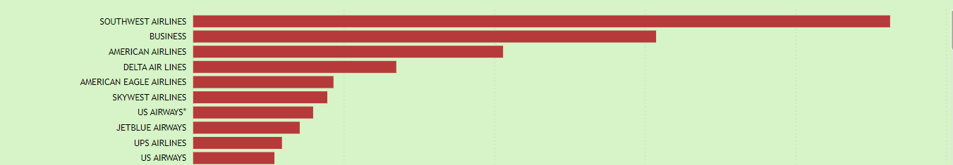
TOP 10 AIRLINES

Slide 11
Top 50 Airports with the Most Bird Strikes
Dallas/Fort Worth Intl. Arpt.: 803 incidents.
Sacramento Intl.: 676 incidents.
Salt Lake City Intl: 479 incidents.
Denver Intl Arpt: 476 incidents.
Kansas City Intl: 452 incidents.
Philadelphia Intl: 442 incidents.
Orlando Intl: 408 incidents.
Baltimore Wash Intl: 401 incidents.
Louisville Intl Arpt: 395 incidents.
John F. Kennedy Intl: 390 incidents.
Charlotte/Douglas Intl Arpt: 367 incidents.
Nashville Intl: 364 incidents.
Lambert-St Louis Intl: 363 incidents.
Chicago O’Hare Intl Arpt: 332 incidents.
Detroit Metro Wayne County Arpt: 321 incidents.
Portland Intl (OR): 313 incidents.
Newark Liberty Intl Arpt: 305 incidents.
Cincinnati/Northern Kentucky Intl Arpt: 302 incidents.
Atlanta Intl: 296 incidents.
Chicago Midway Intl Arpt: 296 incidents.
Houston-Hobby: 294 incidents.
Fort Lauderdale/Hollywood Intl: 277 incidents.
Washington Dulles Intl Arpt: 270 incidents.
Eppley Airfield: 269 incidents.
LaGuardia NY: 263 incidents.

Slide 12
Logan Intl: 255 incidents.
Dallas Love Field Arpt: 253 incidents.
Metro Oakland Intl: 252 incidents.
Minneapolis-St Paul Intl: 251 incidents.
Greater Pittsburgh: 237 incidents.
Austin-Bergstrom Intl: 236 incidents.
San Francisco Intl Arpt: 226 incidents.
New Orleans Intl: 219 incidents.
Los Angeles Intl: 217 incidents.
South West Florida Intl Arpt: 215 incidents.
Cleveland Hopkins Intl Arpt: 214 incidents.
Birmingham Shuttleworth Intl: 211 incidents.
Miami Intl: 202 incidents.
Mineta San Jose Intl: 201 incidents.
George Bush Intercontinental: 199 incidents.
Phoenix Sky Harbor: 196 incidents.
Lihue Arpt: 195 incidents.
San Antonio Intl: 194 incidents.
Buffalo-Niagara Intl: 182 incidents.
Honolulu Intl Arpt: 170 incidents.
Port Columbus Intl: 166 incidents.
Raleigh-Durham Intl: 165 incidents.
Ronald Reagan Washington Intl: 162 incidents.
Indianapolis Intl: 160 incidents.
Jacksonville Intl: 155 incidents.

Slide 13
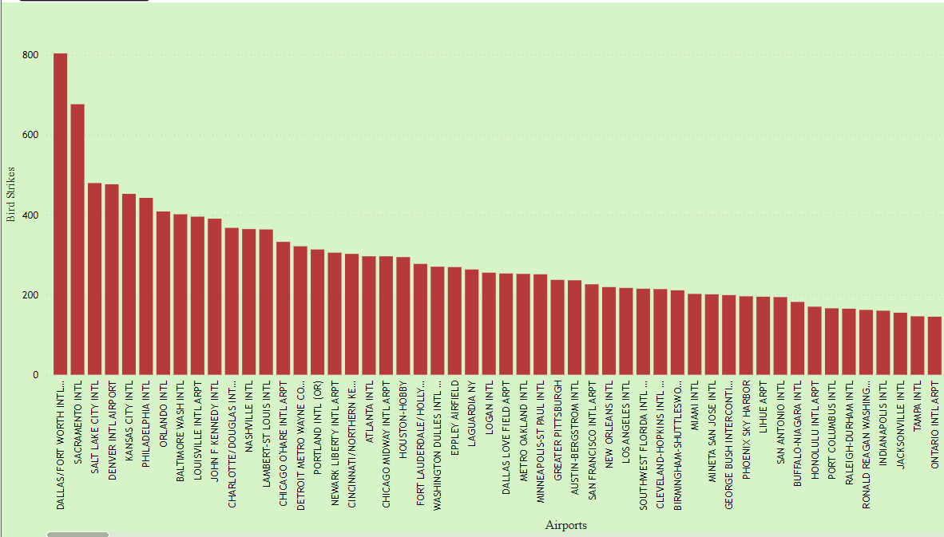
TOP 50 AIRPORTS

Slide 14
Yearly Cost Incurred due to Bird Strikes
2000: 5,625,496
2001: 23,252,168
2002: 9,046,405
2003: 13,176,787
2004: 8,116,866
2005: 7,026,670
2006: 18,309,903
2007: 10,822,426
2008: 11,966,121
2009: 9,564,327
2010: 11,459,879
2011: 13,180,130
Blanks: 743,267
The highest cost incurred was in 2001, amounting to $23.25 million, while the lowest cost was in 2000, with $5.63 million.

Slide 15
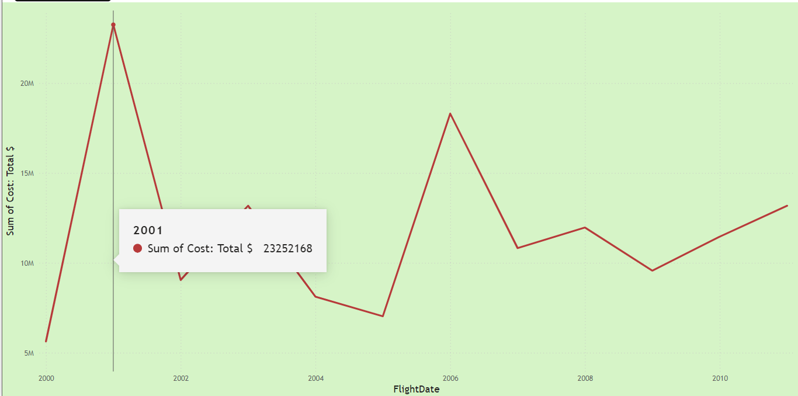
THE HIGHEST COST WAS INCURRED IN 2001

Slide 16
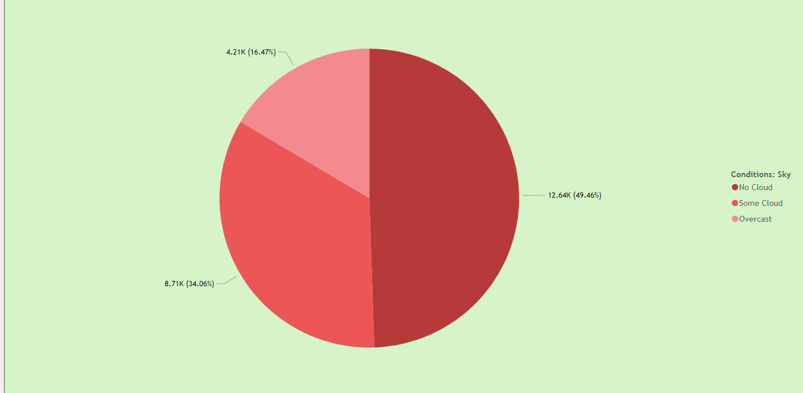
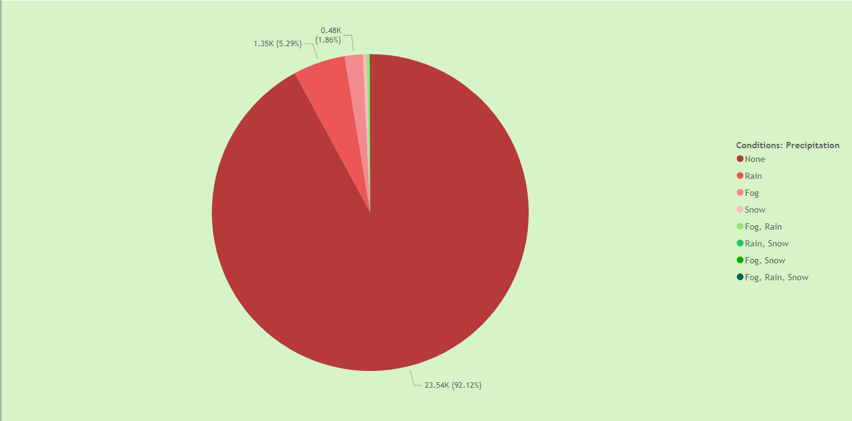
When most Strikes Occur
Sky Condition: Bird strikes were most frequent under clear skies (12,642 incidents).
Precipitation: 23,543 incidents occurred with no precipitation.
SKY CONDITION
PRECIPITATION

Slide 17
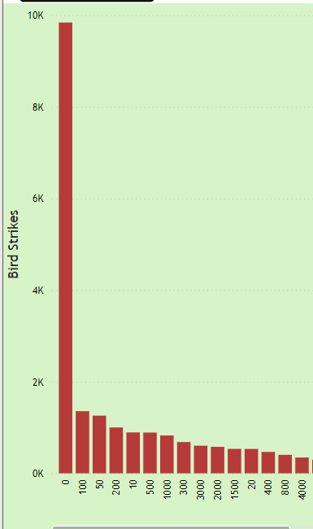
Altitudes of Airplanes at the Time of Strike
Most bird strikes occurred at or near ground level
(0 altitude), with 9,843 incidents.

Slide 18
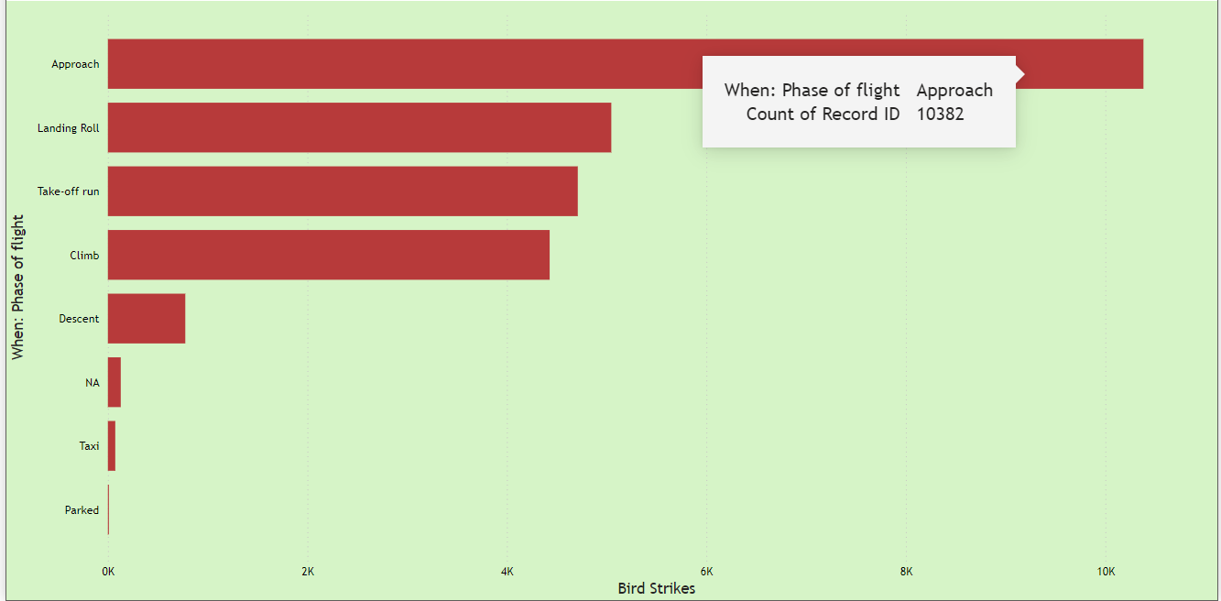
Phase of Flight at the time of Attack
These are the different phases of flight and the number of recorded bird strike incidents:
Approach: 10,382
Landing Roll: 5,047
Take-off run: 4,711
Climb: 4,429
Descent: 776
Taxi: 74
Parked: 10
NA: 129

Slide 19
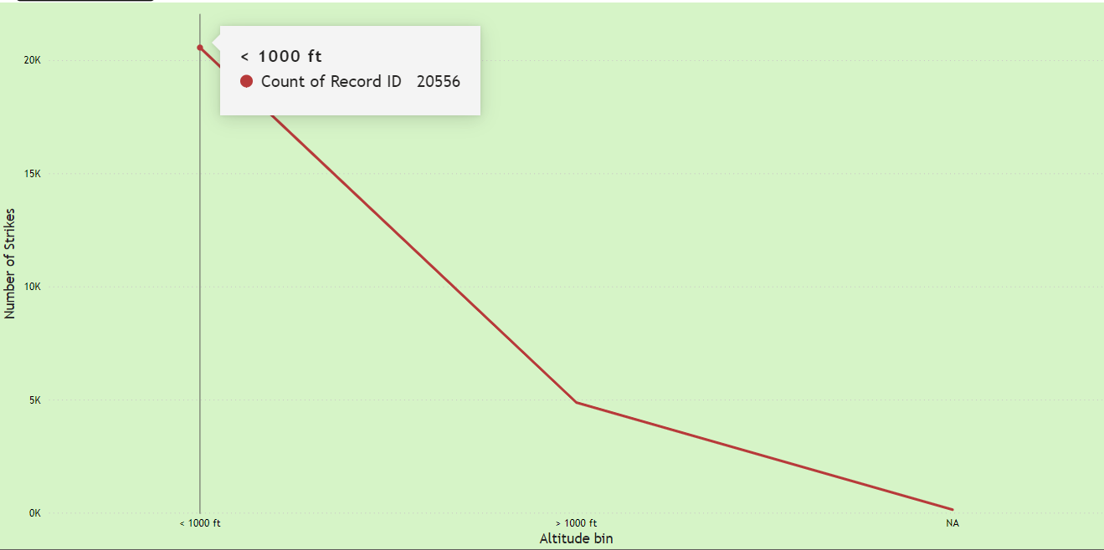
Bird strikes at different Altitude Bin
20,556 incidents of bird strike was recorded at below 1000 ft.
4,873 incidents was recorded above 1000 ft.

Slide 20
Effect of Bird Strike and Impact on Flight
No impact, no damage: 85.33% of incidents (21,808 cases)
Damage with no flight impact: 6.04% (1,543 cases).
Damage, Precautionary Landing: 2.12% (542 cases)
No damage, Precautionary Landing: 2.27% (579 cases).
No damage, Aborted Take-Off: 1.37% (351 cases).
Damage, Aborted take-Off: 0.5% (128 cases).
No damage, other impact: 0.09% (23 cases).
Damage, other impact: 0.64% (163 cases).
Damage, Engine shut-down: 0.31% (78 cases).
No damage, Engine shut-down: 0.04% (10 cases).

Slide 21
Effect of Bird Strikes at Different Altitudes
These are the number of bird strikes that caused damage and those that caused no damage at different altitudes:
Altitude Caused Damage No Damage
0 619 9224
100 98 1259
50 93 1166
200 94 907
10 87 806
500 86 804
1000 109 717
300 77 606

Slide 22
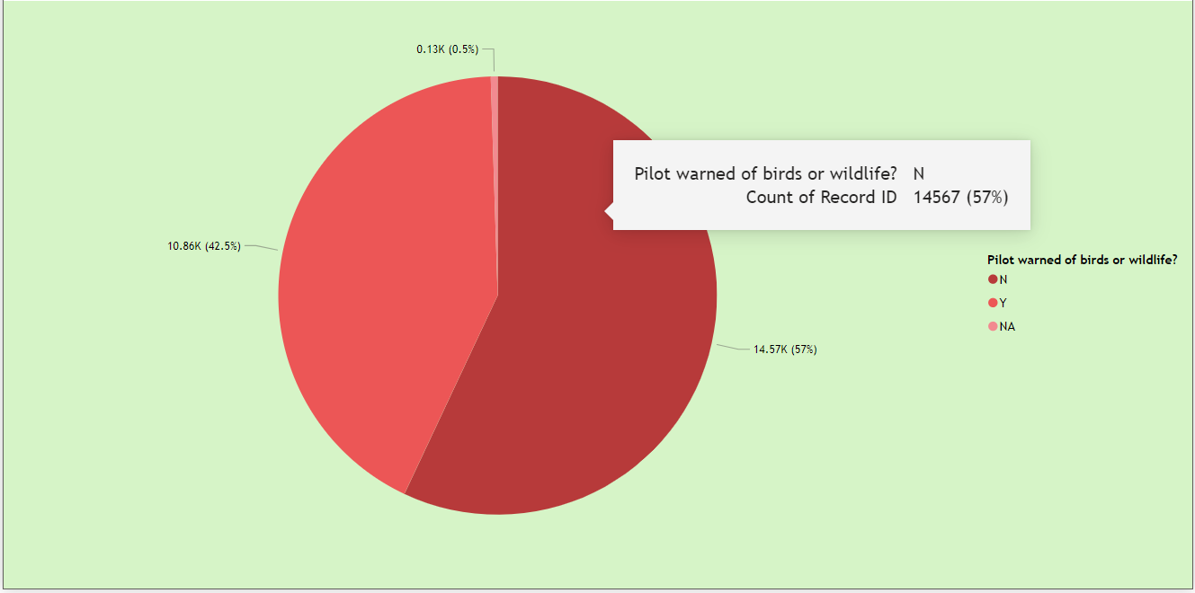
Where Pilots Informed?
57% of incidents occurred without prior warning to the pilots.
42.5% of incidents involved pilots who were informed beforehand.

Slide 23
Impact of Bird Strikes on Flight at Different Phases
The are the impact of strikes and number of times it happened at the different phase of flight
Approach
Engine Shut down: 15
None: 10,030
Other: 188
Precautionary Landing: 149
Landing Roll
Engine shut down: 9
None: 4,927
Other: 102
Precautionary Landing: 9
Climb
Aborted Take-off:12
Engine shut down: 40
None: 3,643
Other: 36
Precautionary Landing: 698
Take-off run
Aborted Take-off: 467
Engine shut down: 23
None: 3,949
Other: 38
Precautionary Landing: 234

Slide 24
Descent
None: 734
Other:12
Precautionary Landing: 30
Taxi
Engine shut down: 1
None:64
Other: 9
Parked
None:4
Other: 5
Precautionary Landing: 1

Slide 25
Damages Caused by Bird Strikes at Different Phases
Approach: Caused Damage - 985
No Damage - 9397
Landing Roll: Caused Damage - 236
No Damage - 4811
Take-Off Run: Caused Damage - 376
No Damage - 4335
Climb: Caused Damage - 694
No Damage - 3735
Descent: Caused Damage - 157
No Damage - 619
Taxi: Caused Damage - 4
No Damage - 7
Parked: Caused Damage - 2
No Damage - 8
NA: Caused Damage - 23
No Damage - 106

Slide 26
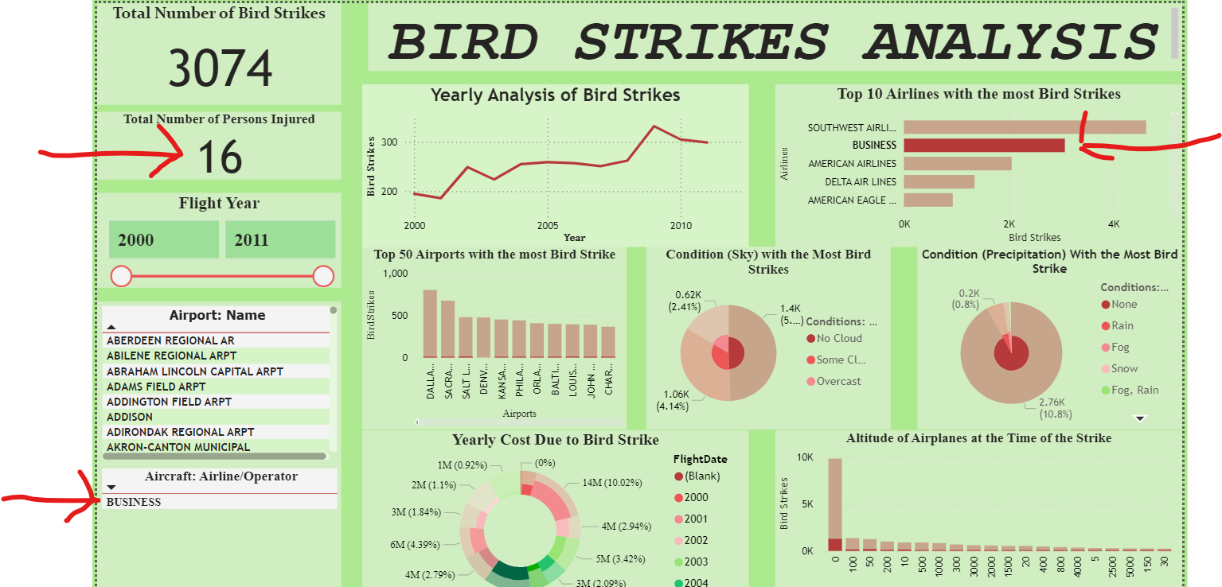
Airline with the Most Number of Injured Persons from Strikes
The Business Airline has the total of 16 injured persons from bird strike out of the total 27 injured persons.

Slide 27
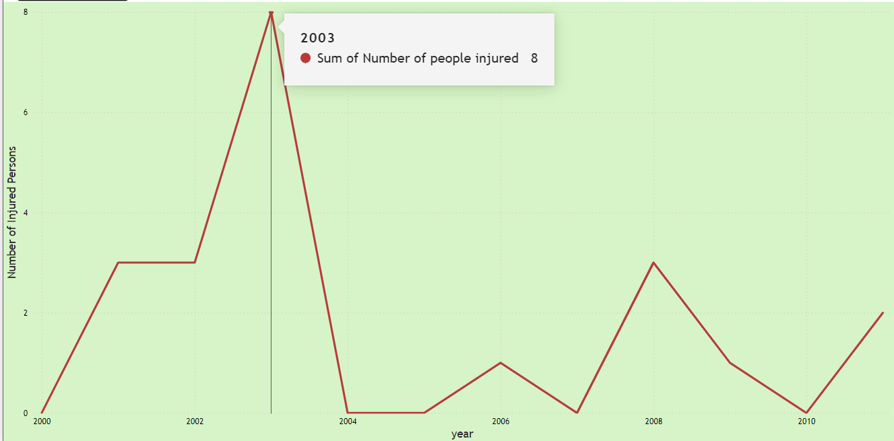
Number of Injured Persons by Year
2000 - 0
2001 - 3
2002 - 3
2003 - 8
2004 - 0
2005 - 0
2006 - 1
2007 - 0
2008 - 3
2009 - 1
2010 - 0
2011 - 2

Slide 28
The Airlines that Struck the Most and Least Number of Wildlife
These are the airlines and the number of times they struck a certain number range of wildlife:
Airlines that Struck the most Wildlife
Airline Number range of Wildlife times Struck
South West Airlines 1 2,428
11 - 100 51
2 - 10 593
Over 100 2
Business 1 2,428
11 - 100 51
2 - 10 593
Over 100 2

Slide 29
Airline Number range of Wildlife times Struck
American Airlines 1 1,742
11 - 100 30
2 - 10 284
Over 100 2
Delta Airlines 1 1086
11 - 100 25
2 - 10 238
American Eagle Airlines 1 723
11 - 100 13
2 - 10 196

Slide 30
Airlines that Struck the Least Number of Wildlife
The airlines Ram Air Freight, Pro Air, Phoenix Air, My Travel Airways, Monarch Airlines, Mid America Jet, Martin Air and Lufthansa Cargo all hit 1 wildlife at once, twice.

Slide 31
INSIGHTS
Annual Trends
Bird strikes peaked in 2009 with 3,247 incidents, while the lowest number of incidents occurred in 2001, with 1,230. This fluctuation may point to variations in aviation traffic, environmental changes, or wildlife behavior. Understanding these factors could lead to more targeted mitigation strategies.

Slide 32
Top Airlines
Southwest Airlines (4,628 incidents) and Business (3,074 incidents) experienced the most bird strikes. This suggests that some airlines might operate in higher-risk environments, and they could benefit from focused bird strike prevention strategies such as more frequent wildlife monitoring and more advanced detection systems.

Slide 33
Airports with Most Bird Strikes
Dallas/Fort Worth International recorded the highest number of strikes (803), followed by Sacramento International (676) and Salt Lake City International (479). High-traffic airports are naturally at more risk, but these locations may need additional wildlife management protocols.

Slide 34
Financial Impact
The year 2001 saw the highest financial loss due to bird strikes ($23.25 million). This underlines the significant economic burden these incidents place on the aviation industry, and it highlights the need for cost-effective mitigation strategies to avoid similar incidents.

Slide 35
Flight Conditions and Altitudes
Most bird strikes occurred under clear skies (12,642 incidents) and with no precipitation (23,543 incidents), indicating that adverse weather conditions are not a significant factor in bird strikes.
Additionally, a large number of strikes occurred at or near ground level, with over 9,800 incidents recorded at 0 altitude, making the approach and takeoff phases particularly vulnerable.

Slide 36
Flight Phases and Impact
The approach phase had the highest number of bird strikes (10,382 incidents), followed by landing roll (5,047) and takeoff run (4,711).
Despite many incidents, 85.33% of the bird strikes caused no damage or impact on flights, but 1,543 incidents (6.04%) caused damage even without flight disruption.

Slide 37
Pilot Awareness
In 57% of cases, pilots were not warned of potential wildlife hazards. This lack of prior warning significantly impacts the ability to prevent or mitigate bird strikes in real-time, underscoring the importance of early detection systems and better communication between wildlife management and flight crews.

Slide 38
RECOMMENDATIONS
Adopt Predictive AI and Multi-Agent Systems (MAS)
Implementing AI-powered bird strike prediction models, especially Multi-Agent Systems, could help aviation operators detect and respond to bird hazards in real-time. These systems could simulate various scenarios and create coordinated responses to prevent strikes during critical phases of flight, such as takeoff and landing.

Slide 39
Increase Wildlife Management at High-Risk Airports
Airports with a high frequency of bird strikes, such as Dallas/Fort Worth and Sacramento, should invest in stronger wildlife control programs. Measures such as habitat management, bird deterrents, and radar-based detection systems could help reduce the risk of bird strikes.

Slide 40
Enhance Pilot Warning Systems
The significant number of incidents where pilots were not informed of bird risks highlights the need for better communication protocols. Improving real-time warning systems through AI-driven tools, which analyze weather conditions, wildlife activity, and flight paths, could enable earlier and more effective responses to potential bird hazards.

Slide 41
Focus on Approach and Take off Phase Interventions
Since the majority of bird strikes occur during the approach and takeoff phases, aircraft operators and airport authorities should implement targeted measures during these phases. For example, scheduling takeoffs and landings during times of lower bird activity or modifying flight paths to avoid known bird habitats could be beneficial.

Slide 42
Cost Mitigation Through Technology
The high costs associated with bird strikes, particularly in 2001, demonstrate the economic need for mitigation solutions. Technologies like drones for bird deterrence and advanced radar systems to monitor bird movements could provide cost-effective ways to reduce the financial impact of bird strikes on airlines.

Slide 43
CONCLUSION
Bird strikes pose a significant challenge to the aviation industry, as seen through the data from 2000 to 2011. With the majority of strikes occurring near ground level and during critical flight phases, it is clear that technological solutions, particularly those leveraging AI and predictive models, are needed to improve safety and reduce economic losses.
By focusing on high-risk airports, enhancing pilot awareness, and improving real-time detection systems, the industry can make significant strides in mitigating bird strikes. Implementing these strategies will not only improve flight safety but also minimize operational disruptions and financial costs associated with bird strike incidents.

